Slide 1
EXPLORATORY DATA ANALYSIS
WEATHER FORECAST API &
TIME-SERIES EDA
A time-series analysis of Cairo's climate using the NASA POWER API
Omar ElDawy
ML Internship — Cellula Technologies | Task 4

Slide 2
Objective
Connect to a public weather API, pull an extended time-series record for one region, and apply EDA techniques built specifically for sequential/temporal data.
1
Acquire
Pull a multi-year daily record from a live weather API
2
Prepare
Structure it as a clean, gap-free time series
3
Explore
Trend, seasonality, decomposition, ACF/PACF, stationarity
4
Interpret
Explain what the patterns mean for future modeling
Cellula Technologies • Weather Forecast EDA — Task 4
2

Slide 3
Part 1 — Data Collection
REGION
API
TIME RANGE
VARIABLES
Cairo, Egypt
NASA POWER
2 years, daily
5 parameters
30.04°N, 31.24°E
No key needed, strong historical coverage
Jan 2023 – Dec 2024
Temp (max/min/mean), Precipitation, Humidity
Why NASA POWER
• No registration or API key — fully reproducible with a single GET request • Provides years of clean daily point data by coordinates • No rate limits hit — one request covered the full 2-year range • Endpoint: power.larc.nasa.gov/api/temporal/daily/point
Cellula Technologies • Weather Forecast EDA — Task 4
3

Slide 4
Part 2 — Data Preparation
Before any analysis, the series was checked for the structural issues that quietly break time-series models.
Date Gaps
Duplicates
Missing Values
Units
0
0
0
Confirmed
Full daily sequence, no missing dates
No repeated timestamps
Every column fully populated
°C, mm/day, % — pulled from API metadata
Result: since no gaps, duplicates, or missing values were found, no interpolation or fill strategy was required — the raw API data was already analysis-ready.
Cellula Technologies • Weather Forecast EDA — Task 4
4

Slide 5
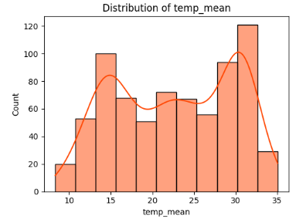
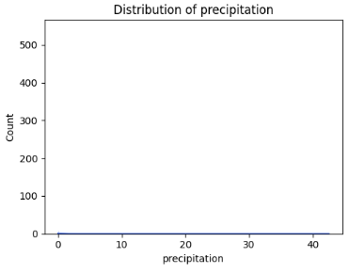
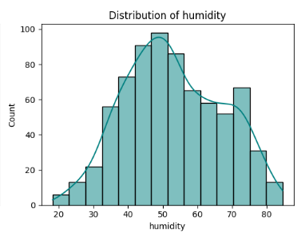
Part 3.1 — Descriptive Overview
Temperature: two seasonal peaks (~15°C, ~30°C) — mild winter vs. hot summer. Precipitation: concentrated near 0mm — expected for Cairo's desert climate. Humidity: roughly normal distribution centered ~50%, no unusual skew.
Cellula Technologies • Weather Forecast EDA — Task 4
5

Slide 6
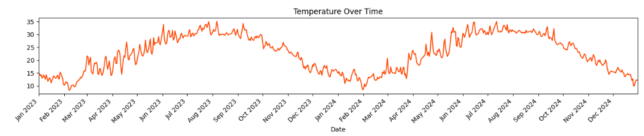
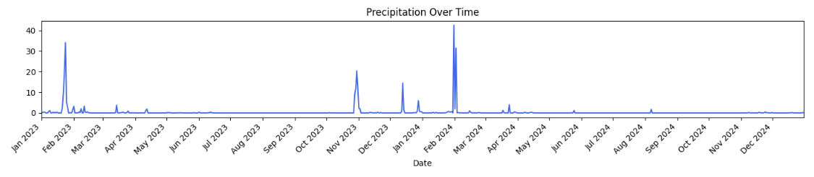
Part 3.2 — Temperature & Precipitation Over Time
Temperature follows a clean repeating seasonal wave. Precipitation stays near-zero almost year-round, with rain spikes clustered in winter.
Cellula Technologies • Weather Forecast EDA — Task 4
6

Slide 7
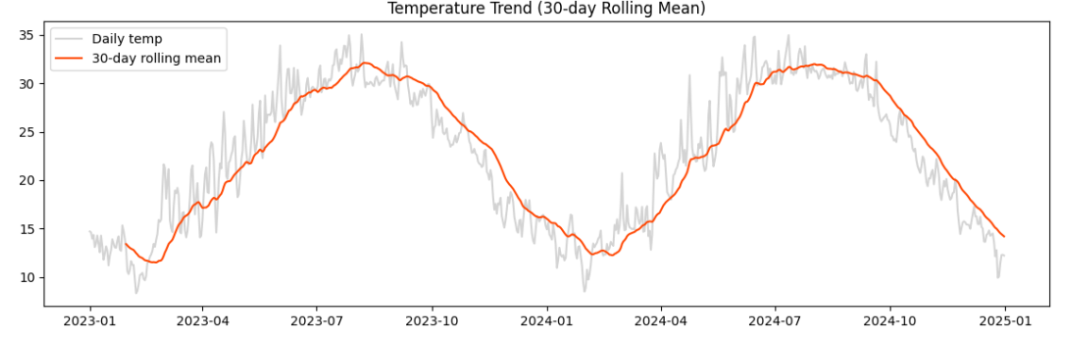
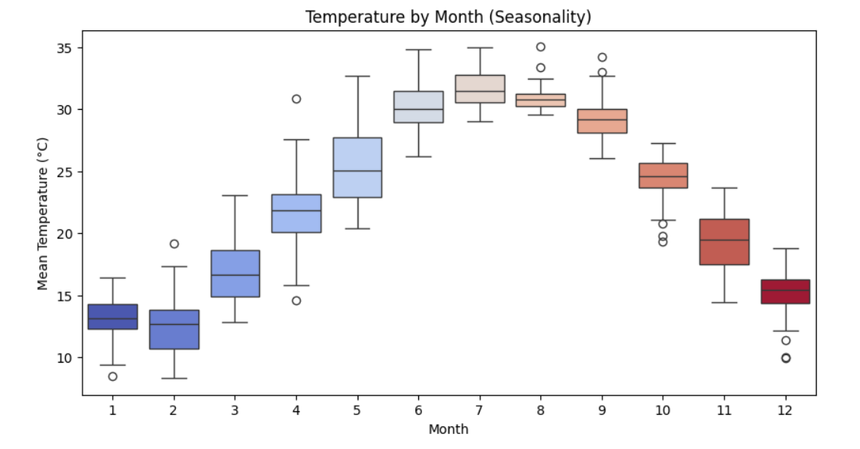
Part 3.2 — Trend & Seasonality
30-day Rolling Mean
2023 and 2024 follow nearly identical seasonal cycles — no long-term warming/cooling trend across the study period.
Jun–Aug are hottest with low variability; Dec–Feb are coldest; spring/autumn transition months show wider spread.
Cellula Technologies • Weather Forecast EDA — Task 4
7

Slide 8
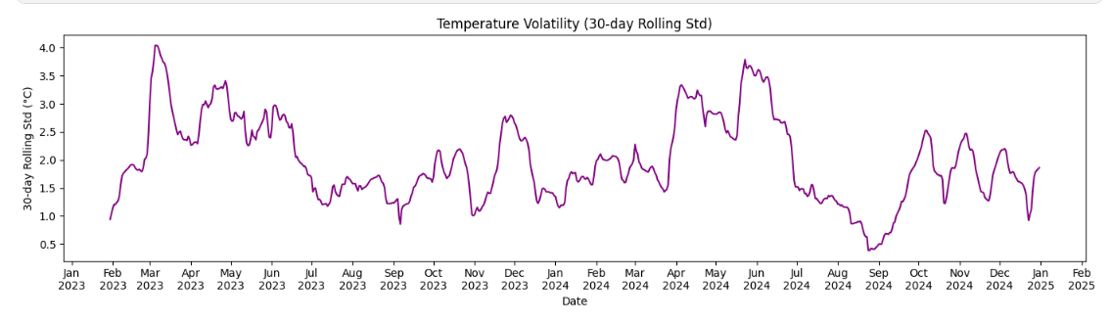
Part 3.2 — Temperature Volatility
Highest volatility: spring transition (Mar–Jun), reaching ~3.5–4°C — the shift into summer heat brings the least predictable temperatures. Lowest volatility: deep summer (Aug–Sep), dropping to ~0.4–0.5°C — the most stable period of the year.
Cellula Technologies • Weather Forecast EDA — Task 4
8

Slide 9
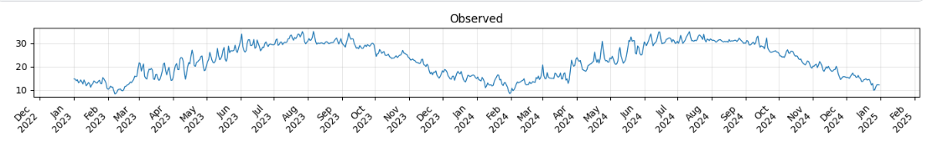
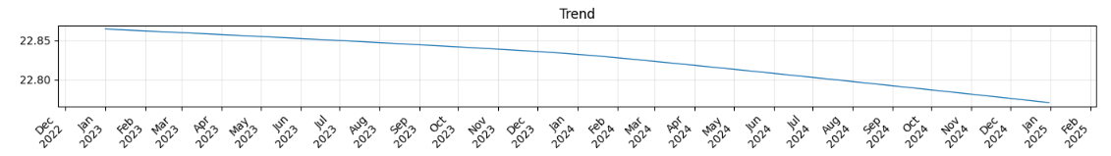
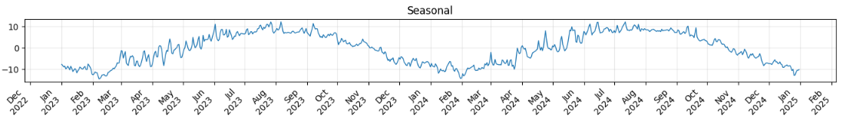
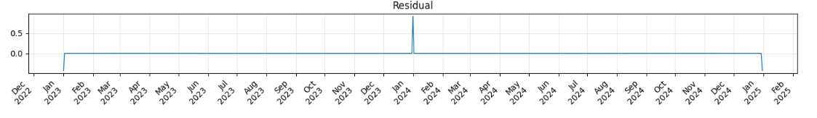
Part 3.3 — STL Decomposition
What each layer shows:
Trend: essentially flat — no meaningful long-term shift. Season: dominates the series — the main driver of temperature. Residual: near-zero, with one spike (~Jan 2024) suggesting a real short weather anomaly, not an error.
Cellula Technologies • Weather Forecast EDA — Task 4
9

Slide 10
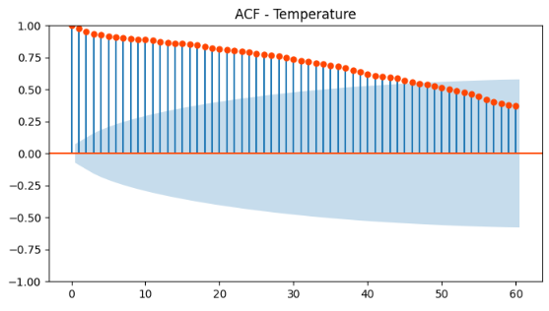
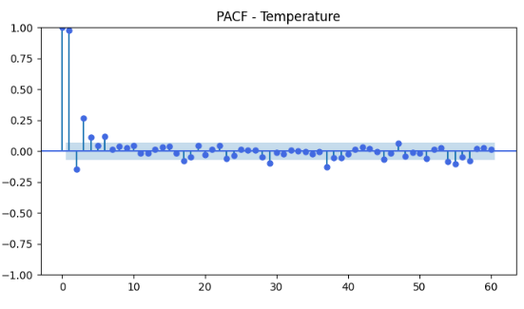
Part 3.3 — Autocorrelation & Stationarity
ACF & PACF
ADF Stationarity Test
ACF decays slowly, staying correlated even at 60-day lags — a seasonality signature. PACF drops sharply after lag 1, so dependency is mostly seasonal, not autoregressive.
p-value = 0.62 → Series is NOT stationary Expected result: the mean temperature shifts predictably by season. Future models would need seasonal differencing or SARIMA rather than a plain model.
Cellula Technologies • Weather Forecast EDA — Task 4
10

Slide 11
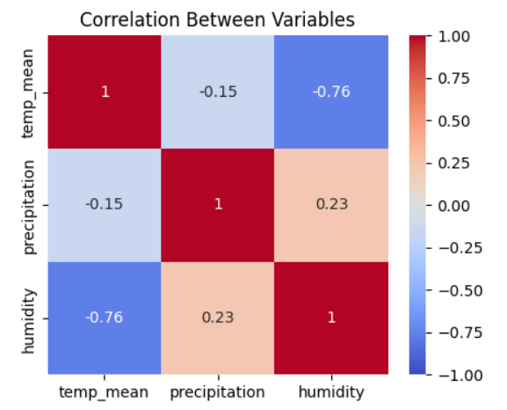
Part 3.4 — Correlation & Anomalies
Correlation
• Temp ↔ Humidity: -0.76 — hotter days are drier (desert climate) • Temp ↔ Precipitation: -0.15 — weak, rain slightly more likely when cooler • Precipitation ↔ Humidity: 0.23 — weak positive link
Outlier Detection (rolling z-score)
6 outliers flagged, all during seasonal transition periods (early spring, late autumn) — matching the high-volatility windows already identified. Real sudden swings, not errors.
Suspicious values (negative rainfall, impossible temps): 0 found — confirms clean, reliable data.
Cellula Technologies • Weather Forecast EDA — Task 4
11

Slide 12
Summary
Cairo, 2 years of daily data via NASA POWER — no key, no rate limits, fully reproducible
Strong, repeating seasonal cycle in temperature; no long-term warming/cooling trend found
Series confirmed non-stationary (ADF p = 0.62) — modeling needs to account for seasonality
Clean dataset: no gaps, duplicates, missing values, or suspicious readings
6 outliers found, all tied to real seasonal transitions rather than data errors
Next: apply these findings toward a forecasting model

